Slide 1
MLAI mini project
From lack of knowledge to useless team member
We have it all

Slide 2
Understanding the TASK
Build an Image classification application to recognize Chinese Number Hand Gestures 3-4-5

Slide 3
Project Details
Task: Image classification for Chinese number hand gesture 3-4-5
Framework: InceptionV3
Training images: 7200
Validation images: 552
Test images: 84

Slide 4
Understanding RPS
Before making image classification for Chinese number hand gesture 3-4-5, we need to understand how RPS works. And that’s what I did

Slide 5
Data Preparation
Collecting band new images can be difficult and labourous, thus some images from RPS dataset was reused to speed up the process. Because someone was supposed to do it but preferred to go hang out and get drunk and when the data is sent over it isn’t 1:1 ratio

Slide 6
Confusion Matrix
https://stackoverflow.com/questions/50825936/confusion-matrix-on-images-in-cnn-keras

Slide 7
CN345 Project
Auntie-DOT
CN345
希薇娅
希薇娅 TI
希薇娅 TI
EfficientNet Variants

Slide 8
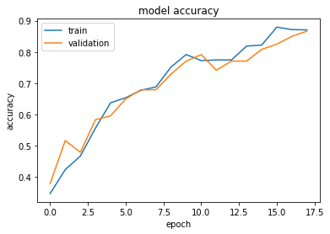
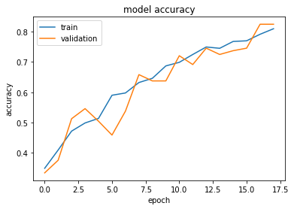
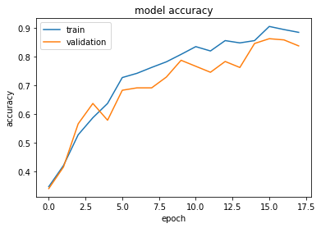
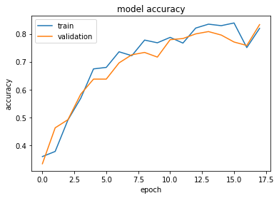
CN345 希薇娅 (InceptionV3)
CN345 希薇娅(CIVIA) is based on RPS and serves as a control setup
Based on the graphs, there is no sign of overfitting and the accuracy of validation and training do not have a wide gap.
Because of how stable it is, it is used as a control setup, to be referenced with when facing issues with the other variants.
CN345 希薇娅 uses a similar dataset as CN345 希薇娅 TI that only contains hand signs 3,4,5

Slide 9
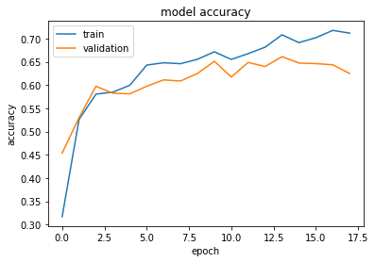
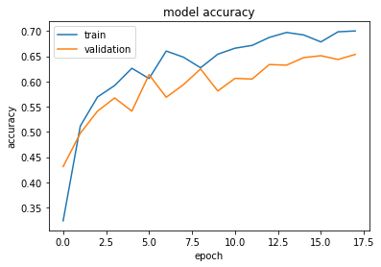
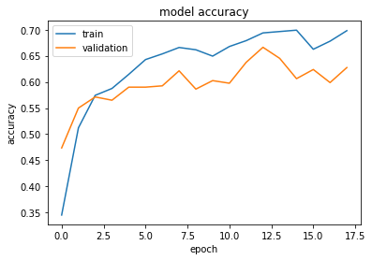
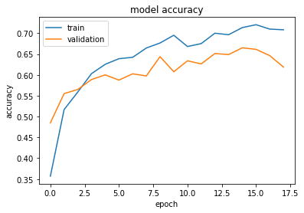
CN345 希薇娅 TI (InceptionV3)
As seen from the graphs, for some reason values for validation is always stuck at 0.100 and the values for train is all over the place and does not seem to make any sense whatsoever.
Modification to the code has been made numerous times however results remain similar to the graphs shown here.

Slide 10
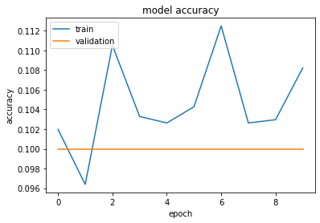
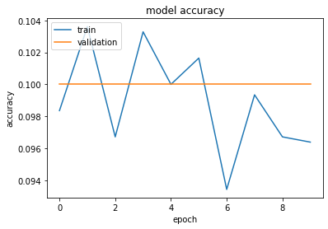
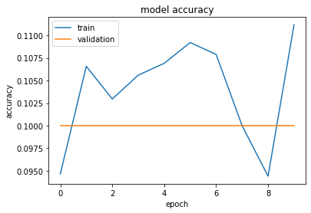
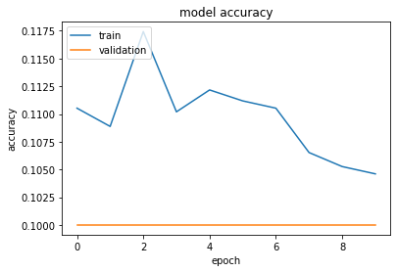
CN345 希薇娅 TI EfficientNet Variants
CN345 希薇娅 TI EfficientNet Variants is an experimental project used to test frameworks
As seen from the graphs, for some reason values for validation is always stuck at 0.100 and the values for train is all over the place and does not seem to make any sense whatsoever.
Modification to the code has been made numerous times however results remain similar to the graphs shown here.
CN345 希薇娅 TI EfficientNet Variants use the same dataset as CN345 希薇娅 TI (InceptionV3)

Slide 11
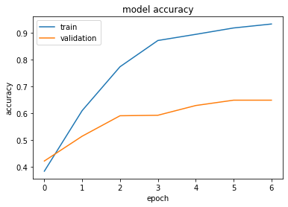
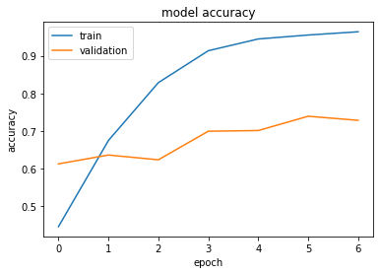
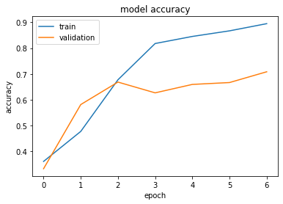
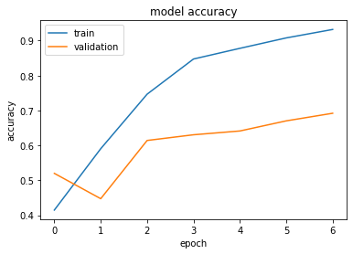
CN345 Auntie-DOT (InceptionV3)
As seen from the graphs, this variant is obviously overfitted and probably needs K-fold to solve this issue.
Modification to the code has been made numerous times however results remain similar to the graphs shown here.
CN345 Auntie-DOT uses a different dataset from the CN345 希薇娅 series

Slide 12
Comparing variants
 | CN345 Auntie-DOT | CN345 希薇娅 | CN345 希薇娅 TI | CN345 希薇娅 TI EfficientNet Variants
Framework | InceptionV3 | InceptionV3 | InceptionV3 | EfficientNetB0/B4/B7
Hand sign range | 3,4,5 | 3,4,5 | 1-10 | 1-10
Training Data | 7200 | 1029 | 3377 | 3377
Validation Data | 552 | 240 | 800 | 800
Test Data | 84 | 60 | 200 | 200
Total Data | 7836 | 1329 | 4377 | 4377
Issues | Overfitted | No known issues | Prediction is awful | I highly doubt it works
Classification App | Launches | Launches | Launches | Launches but just spits errors
RTC app | Launches | Not tested | Not tested | Gave me a Windows BLUE SCREEN

Slide 13
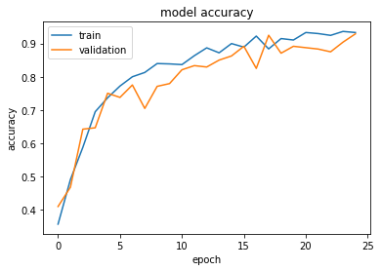
Evaluation

